Slide 1
MCS 8302
CNS 2205
Network Programming

Slide 2
Introduction
Packet filtering firewalls take advantage of the fact that direct support for TCP/IP is built into the kernels of all major operating systems
In Linux, a packet filtering firewall is configured with the IPtables modules
  The iptables tool inserts and deletes rules from the kernel’s packet filtering tables.
When you installed Linux it automatically activates the iptables firewall
  But with an EMPTY packet filtering table
Notes:
https://engineering.purdue.edu/kak/compsec/NewLectures/Lecture18.pdf
https://www.booleanworld.com/depth-guide-iptables-linux-firewall/
Ordinarily, these rules created by the iptables command would be lost on reboot. However, you can make the rules permanent with the commands iptables-save and iptables-restore. The other way is to put the commands required to set up your rules in an initialization script.
Rusty Russell of the Netfilter Core Team is the author of iptables. He is also the author of ipchains that was incorporated in version 2.2 of the kernel and that was replaced by iptables in version 2.4.
The latest packet filtering framework in Linux is known as nftables. Meant as a more modern replacement for iptables, nftables was merged into the Linux kernel mainline on January 19, 2014. nftables was developed to address the main shortcoming of iptables, which is that its packet filtering code is much too protocol specific (specific at the level of IPv4 vs. IPv6 vs. ARP, etc.). This results in code replication when firewall engines are created with iptables.
Despite its many advantages over iptables, there has not yet been a wholesale switchover from iptables to nftables — probably because there do not yet exist tools capable of automatically translating the packet filtering rules written using iptables to the format acceptable to nftables. So the bottom line is that iptables continues to be used widely.

Slide 3
IPTables Firewall
IPtables supports four tables: filter, mangle, nat, and raw
  Filter table has three in-built chains: INPUT, FORWARD, OUTPUT
  The filter table is the default table in iptables
  The other three tables must be called with the ‘-t table-name’ flag
To display firewall rules in IPTables use the command
  iptables -L
    This command is essentially an alias of: iptables -L -t filter
To delete all firewall rules in a table (i.e. flush a table) use the command
  iptables -F

Slide 4
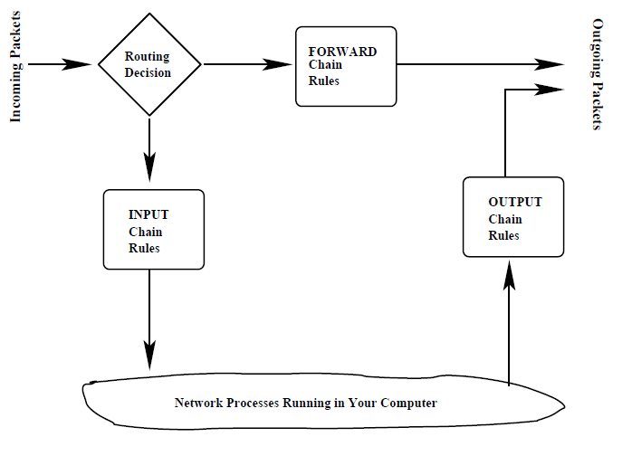
IPTables Firewall

Slide 5
IPTables Firewall
To create (define) a new chain in a table user the command
  iptables -N chain-name
To delete user-defined chains use the command
  iptables –X chain-name

Slide 6
IPTables Firewall
Demo Goal 1: How you can prevent anyone from “pinging” your machine
  Run the command below on a linux machine
  iptables -A INPUT -p icmp --icmp-type echo-request -j DROP
    Where the ‘-A INPUT’ option says to append a new rule to the INPUT chain of the filter (Note: Filter is the default table) table.
    The ‘-p icmp’ option specifies that the rule is to be applied to ICMP packets only.
    The next option in the command line shown above mentions what specific subtype of the ICMP packets this rule applies to.
    Finally, ‘-j DROP’ specifies the action to be taken for such packets.
  You can view the new firewall rule using: iptables -L

Slide 7
IPTables Firewall
  Now use another machine to ping the Linux machine
    ping ip_address_of _Linux_machine (e.g. ping 10.20.113.40)
    You will notice that you will not get back any echos from the Linux machine.
    If you had pinged the Linux machine prior to the entry of the above firewall rule, you would have received the normal echos from that machine.
  You can delete the firewall rule using: iptables -F

Slide 8
IPTables Firewall
Demo Goal 2: How you can allow others to ssh into your machine, but block it for every other access.
  SSH server sshd should be running on the Linux computer
    You can verify that the SSH server is running my executing a command like “ps ax | grep ssh” and you should see a line for the sshd process
  Run the commands
    iptables -A INPUT -p tcp --destination-port 22 -j ACCEPT
    iptables -A INPUT -j REJECT
      where the ‘-A INPUT’ option says to append the rules to the INPUT chain of the filter table.
      The ‘-p tcp’ option says the rule is to be applied to TCP packets.
      The next option mentions the destination port on the local machine for these incoming packets
      Finally, the option ‘-j ACCEPT’ says to accept all such packets.
Notes:
The meaning of “destination port” here corresponds to the field of the same name in the TCP header. So if the value stored in that field of the TCP header in the incoming packet is decimal 22, it will be accepted by the first rule shown above
Recall that 22 is the port registered for the SSH service

Slide 9
IPTables Firewall
    The second rule with -j REJECT means that we reject any packets that don’t match the first rule
  You can view the new firewall rules with: iptables –L
  Now when you use the other laptop to ssh into the Linux computer with its firewall set as above, you should experience no problems.
  However, if the other laptop makes any other type of access (such as by ping) to the Linux laptop, you will receive “Port Unreachable” error message.
    If we had used DROP instead of REJECT in the second rule we entered with the iptables command, when the other laptop makes any access other than ssh to the Linux laptop, the other laptop would not receive back any error messages
Notes:
[When we entered the second iptables command line, we did not specify the -reject-with option, yet it shows up in the second rule in the filter table. Note that, as opposed to DROP, the job of REJECT is to send back an error message. If you don’t specify what this error message should be, iptables will by default use the icmp-port-unreachable option that sends back the Dest Unreachable message.
When you associate a “reject” decision with a port, that means that you are closing that port. And when you associate a “drop” decision with a port, that means that you are not only closing the port, you are also making it invisible to the rest of the network.

Slide 10
IPTables Firewall
Demo Goal 3: How you can prevent others from sending connection-initiation packets (the SYN packets) to your machine.
  iptables -t mangle -A PREROUTING -p tcp -m tcp --tcp-flags SYN NONE -j DROP
    The ‘-t’ option says that the new rule is meant for the mangle table.
    We want the rule to be appended to the PREROUTING chain
    Verify contents of the table with
      iptables -t mangle -L
    To test the firewall You could, for example, try to SSH into the Linux laptop. You will not be able to do.
      You will still be able the ping the Ubuntu laptop since ping packets do not have the SYN flag set
    Clear the firewall rules using: iptables -t mangle -F
Notes:
when a host wants to make a new connection with your machine, it sends your machine a SYN packet
To block all such packets, we could use a rule very similar to what we have shown so far. But, just to add an interesting twist to the demo, we will use the mangle table for the purpose. So go ahead and execute the following command line as sudo:

Slide 11
IP Accounting
Understanding IP Accounting with iptables
Notes:
https://catonmat.net/traffic-accounting-with-iptables
https://wiki.openvz.org/Traffic_accounting_with_iptables
https://www.cyberciti.biz/faq/linux-configuring-ip-traffic-accounting/

Slide 12
IP Accounting with IPTables
Definition of IP Accounting:
  IP accounting, also known as network accounting, is the process of tracking and monitoring network traffic.
  It involves collecting data on the volume of data packets, types of packets, their source and destination, and other relevant information.
Importance of IP Accounting:
  IP accounting plays a crucial role in network management and security.
  It allows administrators to analyze network usage patterns, detect unusual activity, and plan for network optimizations.
  By tracking and measuring network traffic, organizations can make informed decisions regarding resource allocation and capacity planning.
Notes:
https://catonmat.net/traffic-accounting-with-iptables

Slide 13
Key Data Collected in IP Accounting
Packet Counts:
  The number of packets that pass through the network.
Byte Counts:
  The amount of data (in bytes) transmitted or received.
Protocol Types:
  Differentiating between protocols such as TCP, UDP, ICMP, etc.
Source and Destination IP Addresses:
  Identifying the sources and destinations of network traffic.

Slide 14
Use Cases
Network Performance Optimization:
  Understanding how network resources are utilized helps in optimizing the performance by identifying bottlenecks and optimizing the network architecture accordingly.
Security Monitoring:
  IP accounting enables the detection of suspicious or malicious activities, helping to mitigate potential security threats, intrusions, or attacks on the network.
Resource Allocation:
  By monitoring the traffic patterns, administrators can allocate resources effectively to ensure smooth network operation and user satisfaction.

Slide 15
UFW
Uncomplicated Firewall (UFW) is a front-end for managing iptables rules and providing an easier interface for configuring firewall settings in Linux.

Slide 16
Introduction
Definition of UFW:
  Uncomplicated Firewall (UFW) is a front-end for managing iptables rules and providing an easier interface for configuring firewall settings in Linux.
  It aims to make firewall management accessible to both novices and experienced users.
UFW Features and Capabilities:
  Simple syntax for rule creation and management.
  Easy-to-understand rule structure, making it suitable for quick rule setup.
  Integration with application profiles for commonly used services.
  IPv4 and IPv6 support.

Slide 17
Advantages of UFW
Simplicity and Ease of Use:
  UFW provides a simple and intuitive command-line interface, making it accessible even for those unfamiliar with iptables.
  Commands and syntax are straightforward, reducing the learning curve for beginners.
Integration with Other Tools:
  UFW integrates well with other system utilities and services, allowing seamless security configuration and management in a Linux environment.
Default Settings and Rules:
  UFW sets a default policy of denying incoming connections, providing an additional layer of security.
  Users can easily configure exceptions to this policy for specific services they want to allow.

Slide 18
Basic UFW Commands
ufw enable: Enabling UFW:
  This command activates the firewall based on the existing rules.
ufw disable: Disabling UFW:
  Useful for troubleshooting or maintenance.
ufw default: Setting Default Policies:
  Default policies define the behavior for traffic that doesn't match specific rules.
ufw allow: Allowing Traffic:
  Allows packets for specified services e.g. SSH or HTTP traffic.
ufw deny: Denying Traffic:
  Blocks packets for specified services
ufw status: Checking Status:
  Check the status of UFW to view active rules and policies.

Slide 19
Creating Rules with UFW
UFW rules are created using a simple syntax that includes specifying ports, protocols, and addresses.
  The basic syntax is ufw [rule] [port/protocol], where [rule] is either 'allow' or 'deny'.
Example rule to allow incoming traffic to port 80 (HTTP):
  ufw allow 80/tcp
Allow DNS (Port 53):
  ufw allow 53/udp
Allow ICMP (Ping):
  ufw allow icmp
Allow a Specific Range of IP Addresses:
  ufw allow from 192.168.1.0/24
Allow a Range of Ports:
  ufw allow 8000:9000/tcp
Allow All Traffic from a Specific Interface:
  ufw allow in on eth0
Deny Specific IP Address:
  ufw deny from 10.0.0.1
Delete a Rule:
  ufw delete allow 80/tcp
Reset UFW to Default Settings:
  ufw reset
Show Added Rules:
  ufw show added

Slide 20
Fail3Ban
Intrusion Prevention and Log Analysis

Slide 21
Introduction
Definition: Fail2Ban is an open-source intrusion prevention software that protects servers from brute-force attacks and other malicious activities.
Objective: The primary goal of Fail2Ban is to enhance system security by automatically blocking IP addresses that exhibit suspicious or malicious behavior.
Functionality: It continuously monitors system logs, analyzes log entries, and dynamically adjusts firewall rules to restrict access from malicious IP addresses.
Notes:
The Power of Fail2Ban
Proactive Security: Fail2Ban enables proactive security measures by identifying and blocking potential threats before they can cause harm.
Adaptive Protection: Its adaptive nature ensures that security measures evolve to counter new and emerging threats effectively.
Minimized Risk: By swiftly blocking malicious IPs, it minimizes the risk of unauthorized access and potential system compromise.
https://www.digitalocean.com/community/tutorials/how-fail2ban-works-to-protect-services-on-a-linux-server

Slide 22
Key Concepts of Fail2Ban
Jails:
  These serve as designated security zones, segregating misbehaving IP addresses and restricting their potential harm.
Filters:
  Formulating the rules of engagement, filters define patterns of behavior that prompt Fail2Ban to take action.
Actions:
  When triggered by filters, Fail2Ban executes predefined responses—ranging from temporary bans to notifying administrators—tailored to uphold the integrity of the system.

Slide 23
How Fail2Ban Works
Log Monitoring:
  Fail2Ban actively scans system logs (e.g., SSH, Apache, Nginx logs) to identify patterns of malicious activity.
Rule Matching:
  It employs predefined or customizable rules to match and identify unauthorized access attempts and other security violations.
IP Ban:
  Fail2Ban dynamically updates the firewall rules to block the IP addresses that violate the defined rules, effectively preventing further access from those IPs.
  The ban action can involve updating firewall rules to deny further access from that IP.
Automatic Unban:
  Fail2Ban provides a mechanism to automatically lift the ban after a specified period, allowing legitimate users to regain access.

Slide 24
Key Features of Fail2Ban
Log Monitoring and Analysis
  Fail2Ban actively monitors system logs in real-time, analyzing log entries to detect suspicious activities.
Dynamic Firewall Rules
  Fail2Ban dynamically modifies firewall rules to block IP addresses that violate defined rules.
Configurable Jail Rules
  Fail2Ban allows administrators to define and customize ban rules and thresholds for different services and applications.
Email Notifications
  Fail2Ban can send email notifications to administrators, informing them of banned IPs and other critical security events.
Multi-Protocol Support
  Fail2Ban supports various protocols and services, including SSH, Apache, Nginx, and more.

Slide 25
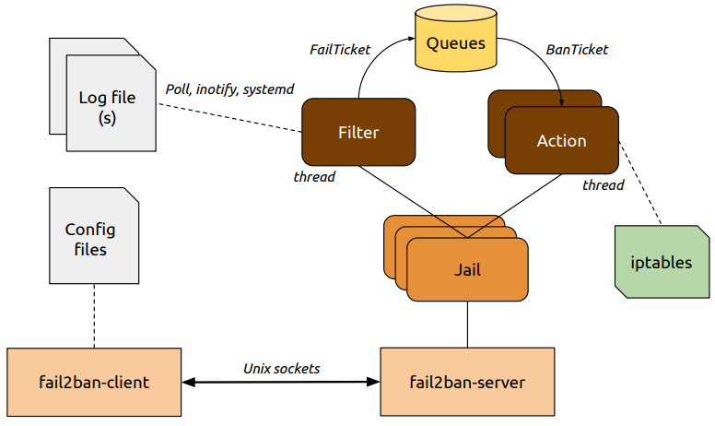
Fail2Ban Architecture

